Slide 1
Threat Prioritization – Candidate Risking
AVCDL-Foundation-9.1.2
Charles Wilson
Staff Product Cybersecurity Architect
version 2
2026-08-26
Notes:
Script:
I'm Charles Wilson, staff product cybersecurity architect at Torc Robotics.
This presentation will cover the Threat Prioritization Candidate Risking activity.

Slide 2
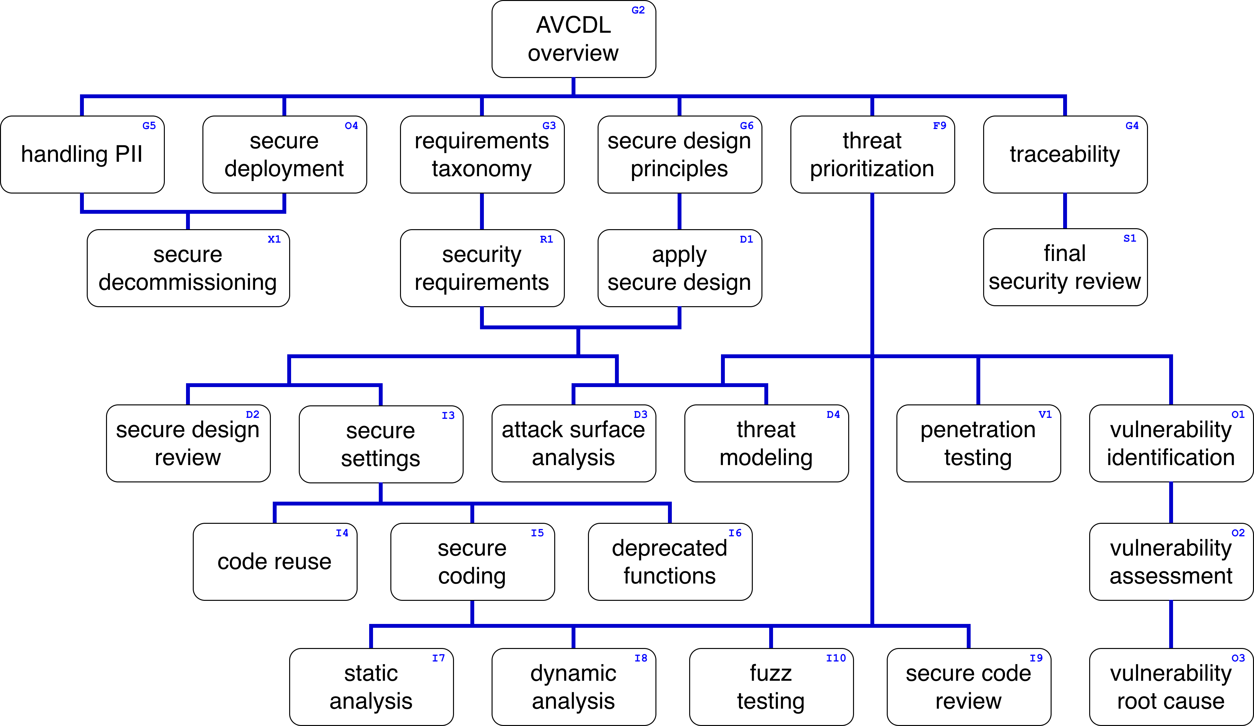
Training Path
Notes:
Script:
This diagram shows the overall AVCDL training path.
If you're taking this training, it's assumed that you've already completed
[pause]
the AVCDL Overview training.
And additionally, that you've completed
[pause]
the Threat Prioritization Overview
and
Threat Prioritization - Candidate Ranking
trainings.
This training covers the Threat Prioritization - Candidate Risking activity.

Slide 3
Workflow
Notes:
Script:
Before getting into threat candidate risking, let's briefly review where it fits in the overall threat prioritization process.

Slide 4
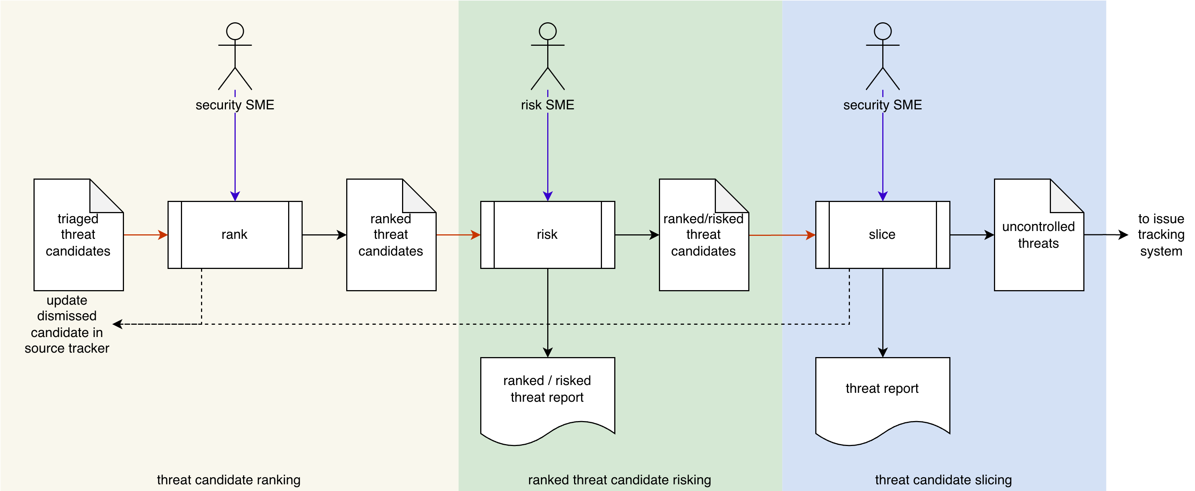
Process Workflow
Notes:
Script:
Here's the threat prioritization process which we previously covered in the Threat Prioritization Overview training.
[break]
Our focus for this training will be on the second activity, that of threat candidate risking.

Slide 5
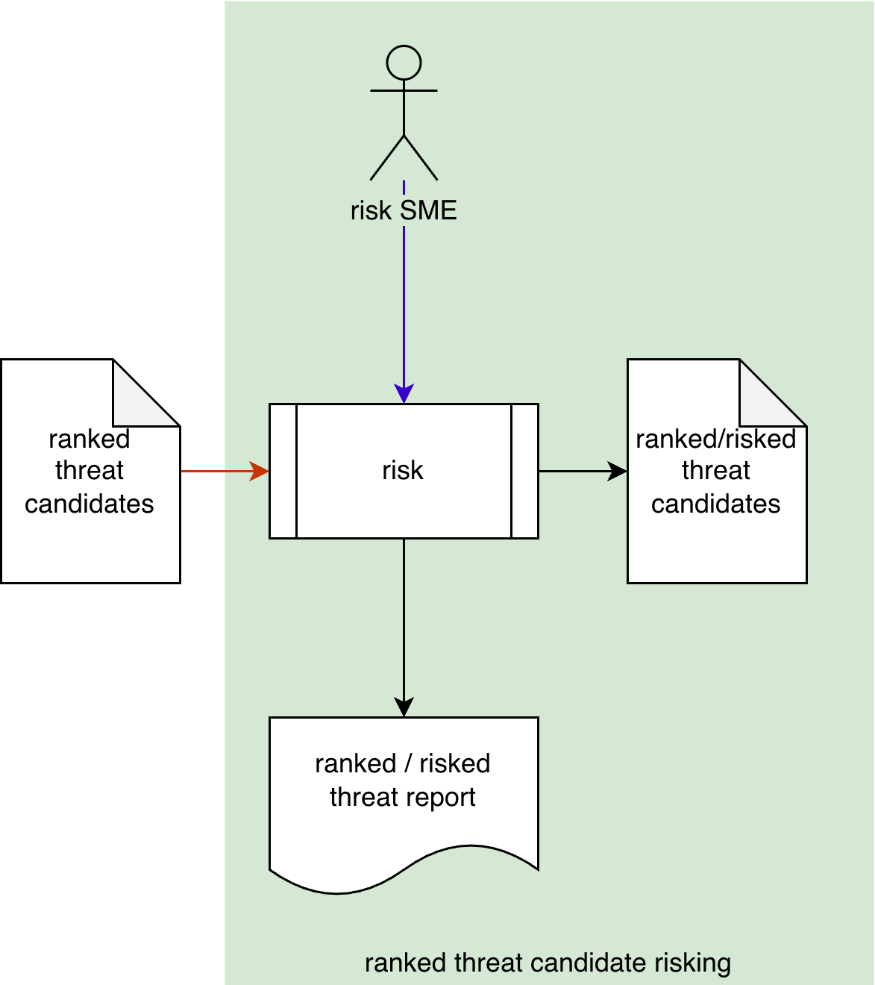
Process Workflow
Notes:
Script:
Here's the threat prioritization process which we previously covered in the Threat Prioritization Overview training.
[break]
Our focus for this training will be on the second activity, that of threat candidate risking.

Slide 6
Candidate Risking Activity
Impact
System level
Notes:
Script:
In the threat candidate risking activity,
[pause]
the risk SME takes
[pause]
the ranked threat candidates
[pause]
and conducts a risk analysis of them, producing
[pause]
a list of ranked / risked threat candidates.
[pause]
And a ranked / risked threat report is generated.
[pause]
Threat candidate risking entails determining
[pause]
the impact of each threat candidate.
[pause]
Here the focus is at
[pause]
the system level.
Because it's at this level that risk determination can be made.
Specifically, the risk SME is evaluating how the threat candidates impact the system based on the worst case scenario provided for the ranked threat candidate.
[pause]
Let's start by considering how impact is determined.

Slide 7
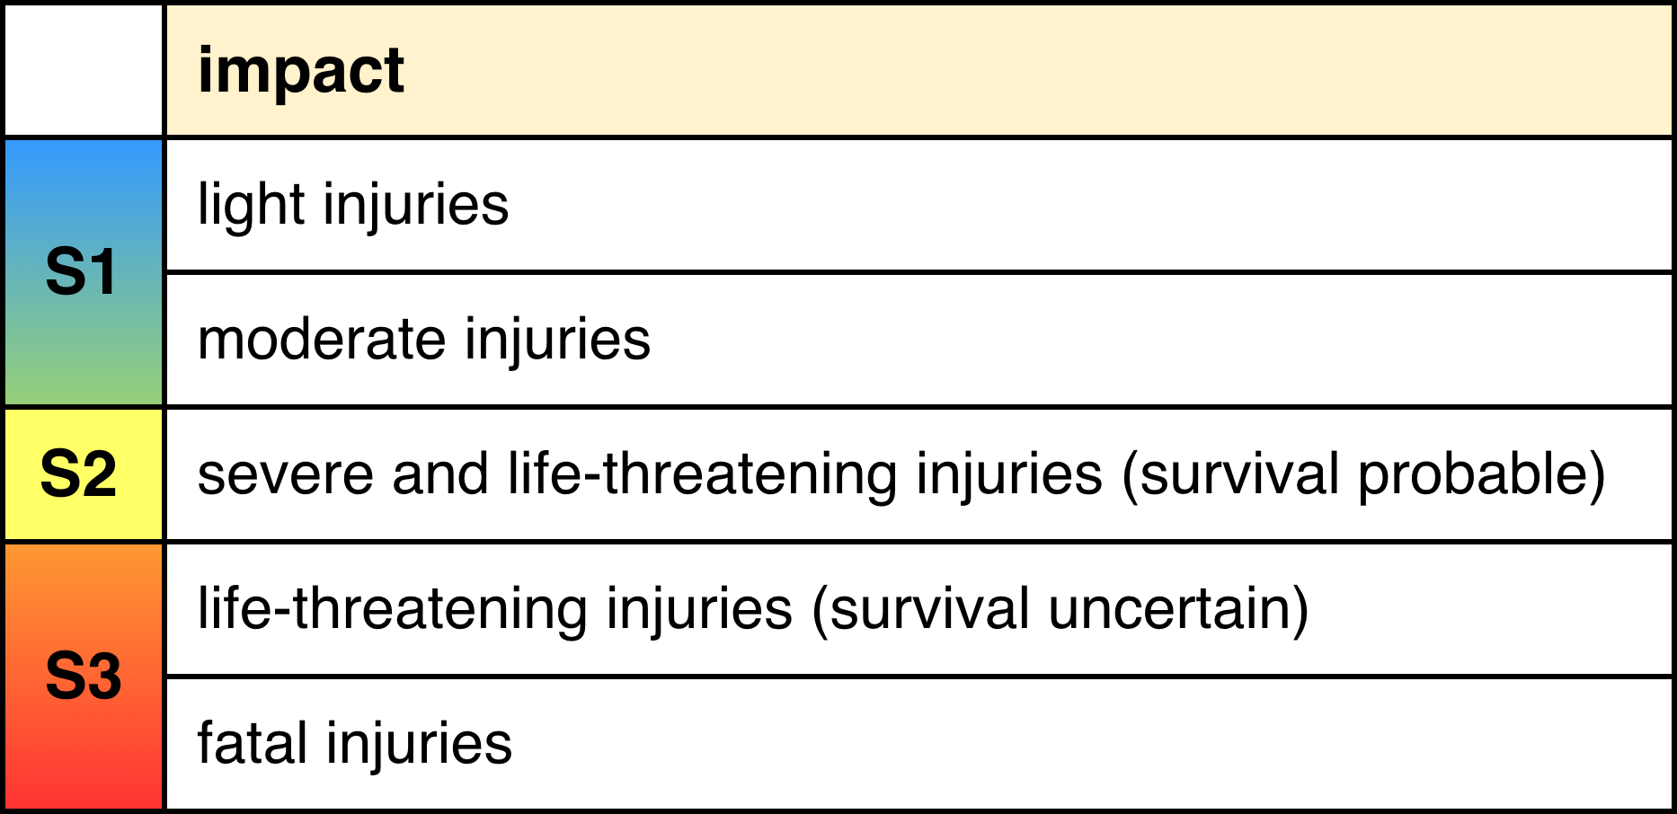
Impact Rubrics
ISO 26262
ISO 14971
FIPS 199
NIST SP 800-30 Table H-3
Notes:
Script:
Now let's consider some commonly used rubrics for determining impact.
This is not an exhaustive list and is in no particular order.
Our first rubric is in
[pause]
ISO 26262.
It deals with vehicle safety.
It has three levels of impact.
These are:
• S1, covers light injuries and moderate injuries
• S2, covers severe and life-threatening injuries, where survival is probable
and
• S3, covers life-threatening injuries, where survival is uncertain and fatal injuries
[pause]
The next rubric is in
[pause]
ISO 14971.
This addresses medical device safety.
It has the following for its impact levels:
• negligible, inconvenience or temporary discomfort
• minor, temporary injury or impairment, not requiring professional medical intervention
• serious, injury or impairment, requiring professional medical intervention
• critical, permanent impairment, or life-threatening injury
and
• catastrophic, which is death
[pause]
For our next rubric we’ll pivot to the IT space, and this rubric is contained in
[pause]
FIPS 199.
It has three levels, they are:
• low, limited adverse effect
• moderate, serious adverse effect
and
• high, severe or catastrophic adverse effect
[pause]
Our final impact rubric brings us back to
[pause]
NIST 800-30.
Just as the likelihood impact from that standard was generalized, so is its impact rubric.
It has levels of:
• very low for a negligible adverse effect
• low for a limited adverse effect
• moderate for a serious adverse effect
• high for a severe or catastrophic adverse effect
and
• very high for multiple, severe or catastrophic adverse effects
[pause]
Unlike the previous three rubrics, which only specify levels of impact, with SP 800-30, ranges are provided for each level,
[pause]
as shown here.
And just as with the SP 800-30 likelihood rubric, the distribution of those ranges is like a normal distribution centered on the moderate level.
This won’t impact how we would apply this rubric in the context of impact determination, because we're going to work directly with the levels.
This information, however, will be used in the slicing activity.

Slide 8
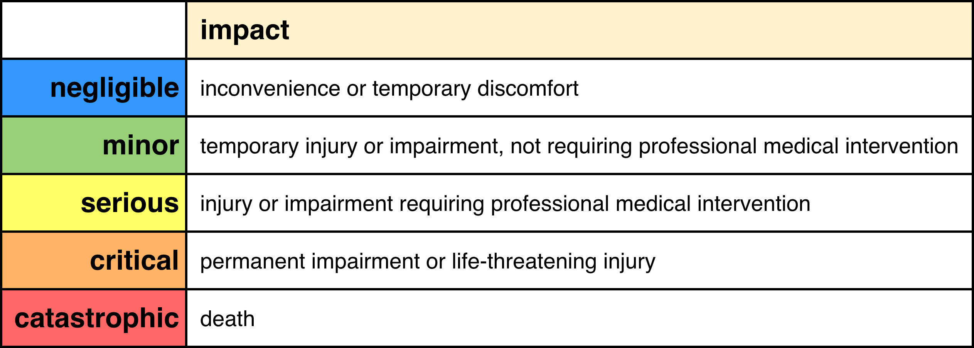
Impact Rubrics (Overlay 14971)
Notes:
overlay

Slide 9
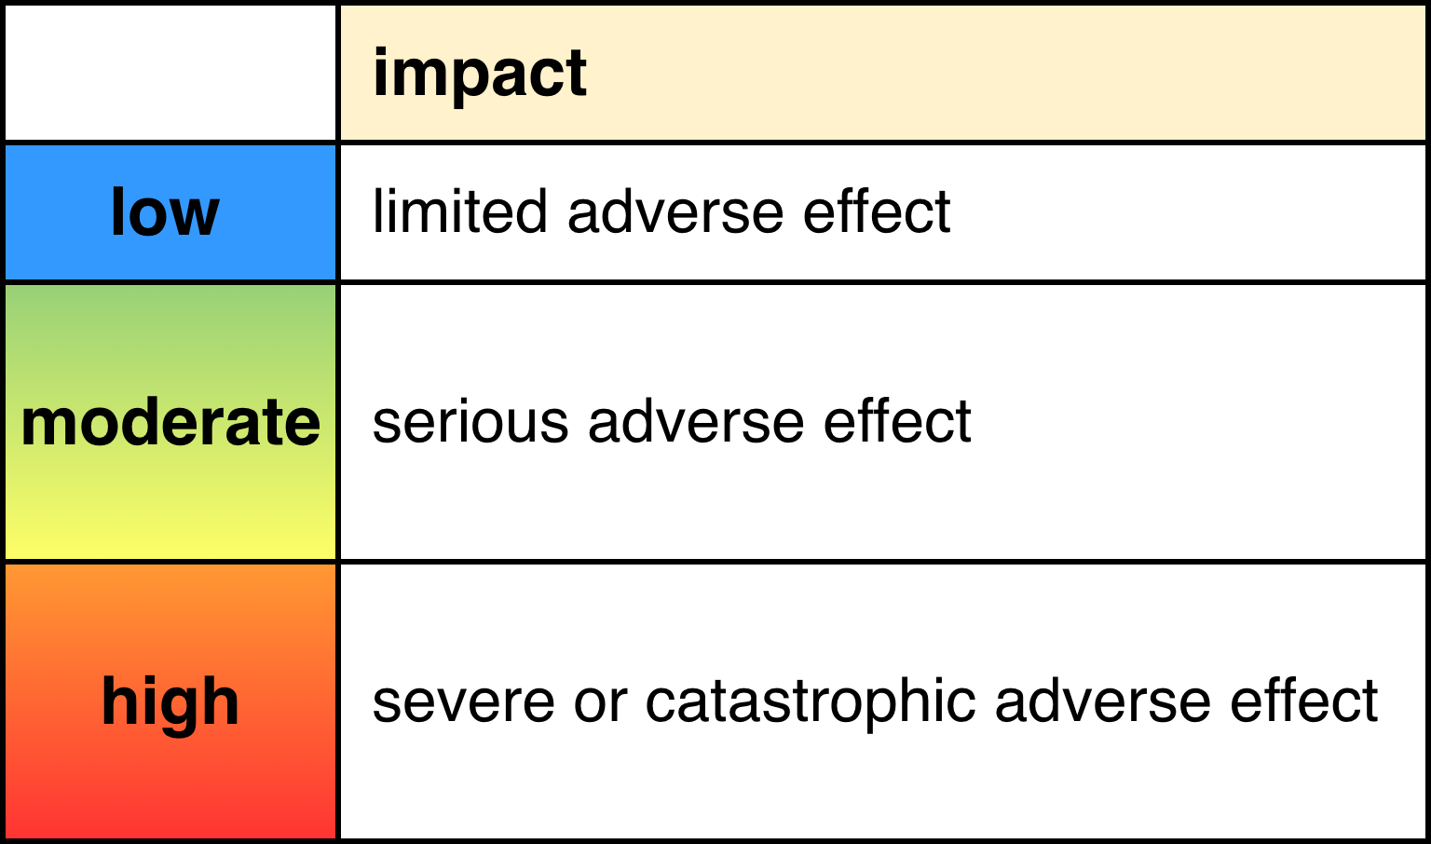
Impact Rubrics (Overlay 199)
Notes:
overlay

Slide 10
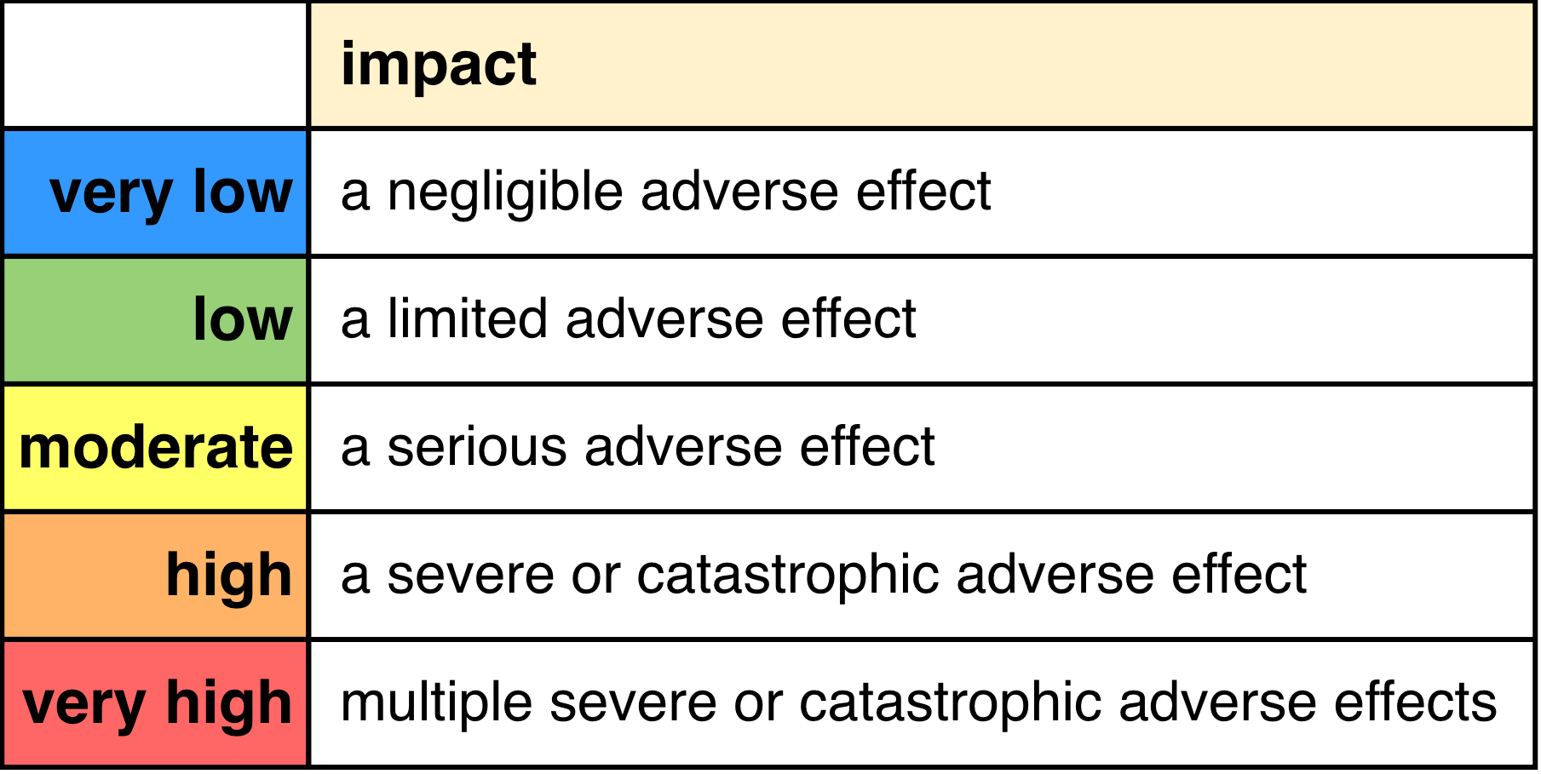
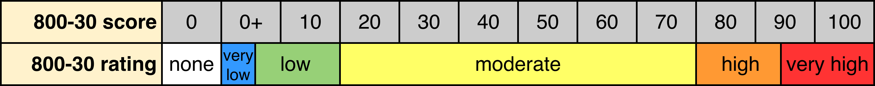
Impact Rubrics (Overlay 800-30)
Notes:
overlay

Slide 11
Example
Notes:
Script:
Now let's work our way through an example to illustrate how threat candidate risking is performed.
We're going to use the output from our earlier threat candidate ranking exercise.

Slide 12
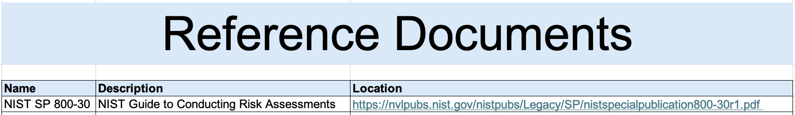
Reference Documents
Notes:
Script:
Here's the reference document sheet from our instantiated template used in this example.
Here we see that the rubric being used is
[pause]
NIST SP 800-30.
We provide its description and where it can be found.
The other references that we would have here would be for the materials that we're using.

Slide 13
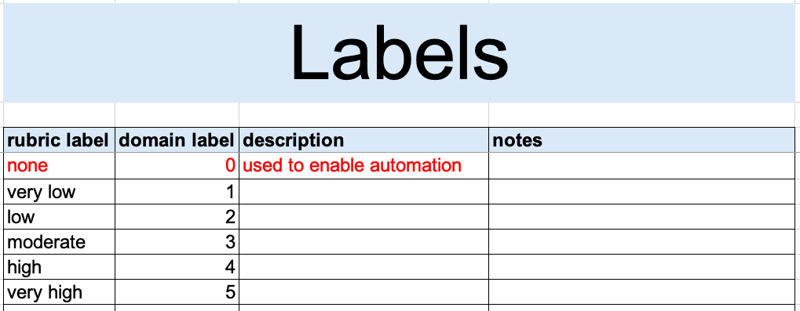
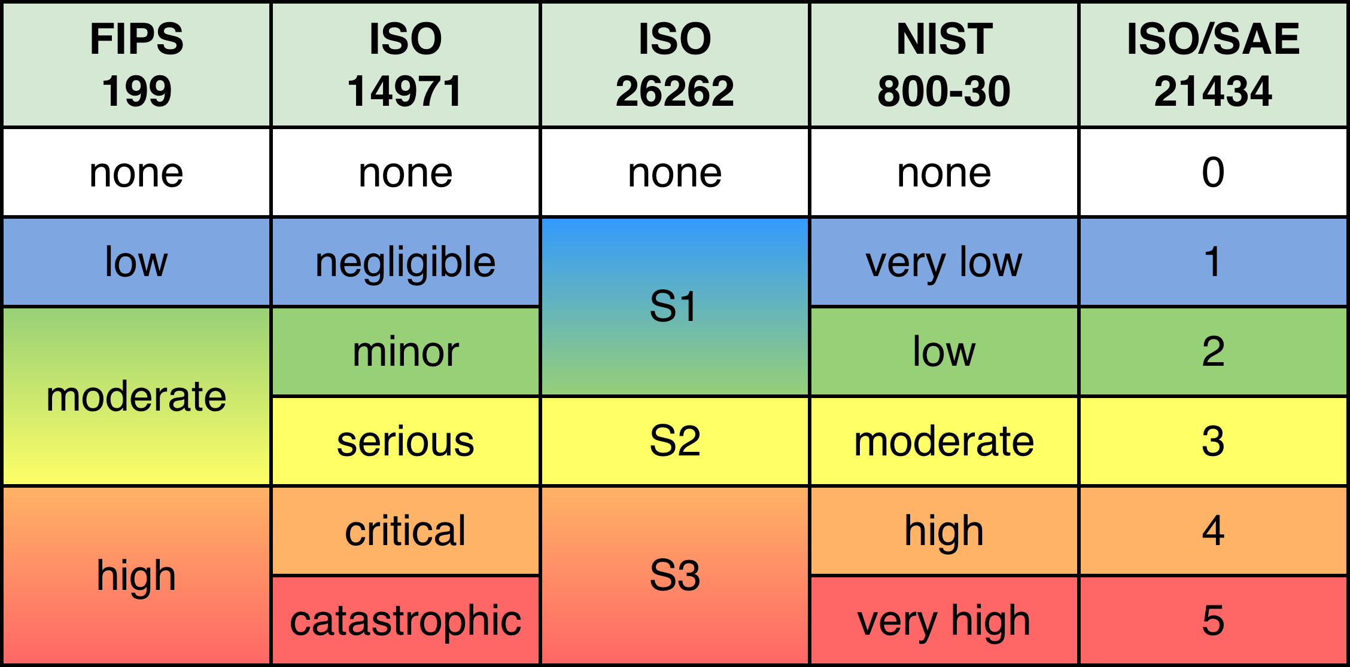
Label Mapping
Notes:
Script:
Before being able to actually get into the risking itself, we need to configure the workbook.
Specifically, we need to establish
[pause]
the labels that we're going to use for the rubric.
Since we're using SP 800-30, we'll be putting those in.
You can see that in this table
[pause]
here.
In case you were wondering about the earlier use of color and spacing for each of the definition sets for the rubrics, we can do a
[pause]
side-by-side comparison
which should give things a bit more context.
The reason we do this is so that, based on the definitions from each rubric, we can establish a rough alignment of the values.
This becomes useful when more than one rubric is in play, and you are trying to get a sense of what the overall impacts are going to be.
Additionally, if we have a system domain requirement, as we did when dealing with likelihood, we need to establish a mapping for that.
[pause]
Shown here we are again using ISO/SAE 21434, vehicle cybersecurity.
We see that this standard specifies a set of numeric values to be used, which have no set meaning.
[pause]
These are entered into the domain label column.
And, just as with likelihood, we're going to add
[pause]
a value of none, or in the case of the domain mapping zero because that's all numeric.
We do this in order to assist us with automation.
These values for the rubric and domain will be used to populate dropdowns in the ranking sheet of the workbook.

Slide 14
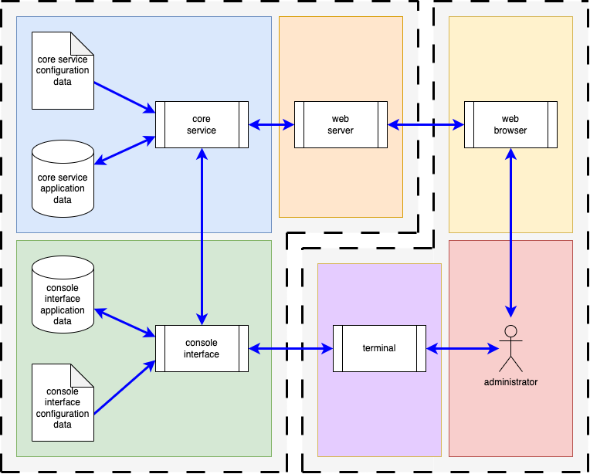
Example System
Notes:
Script:
Once again, we're going to use our same example system with our administrator interactor
[pause]
on the right, and our core service, web server, and console interface
[pause]
on the left.
We won’t go into detail here because we've covered that in the previous training.
If you need a refresher, then review that video.

Slide 15
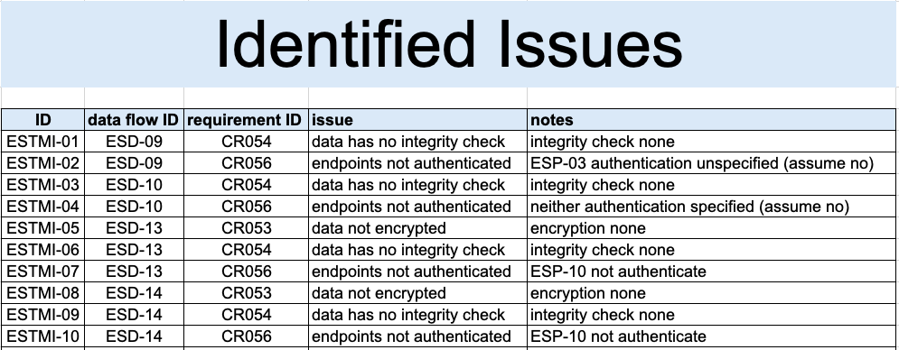
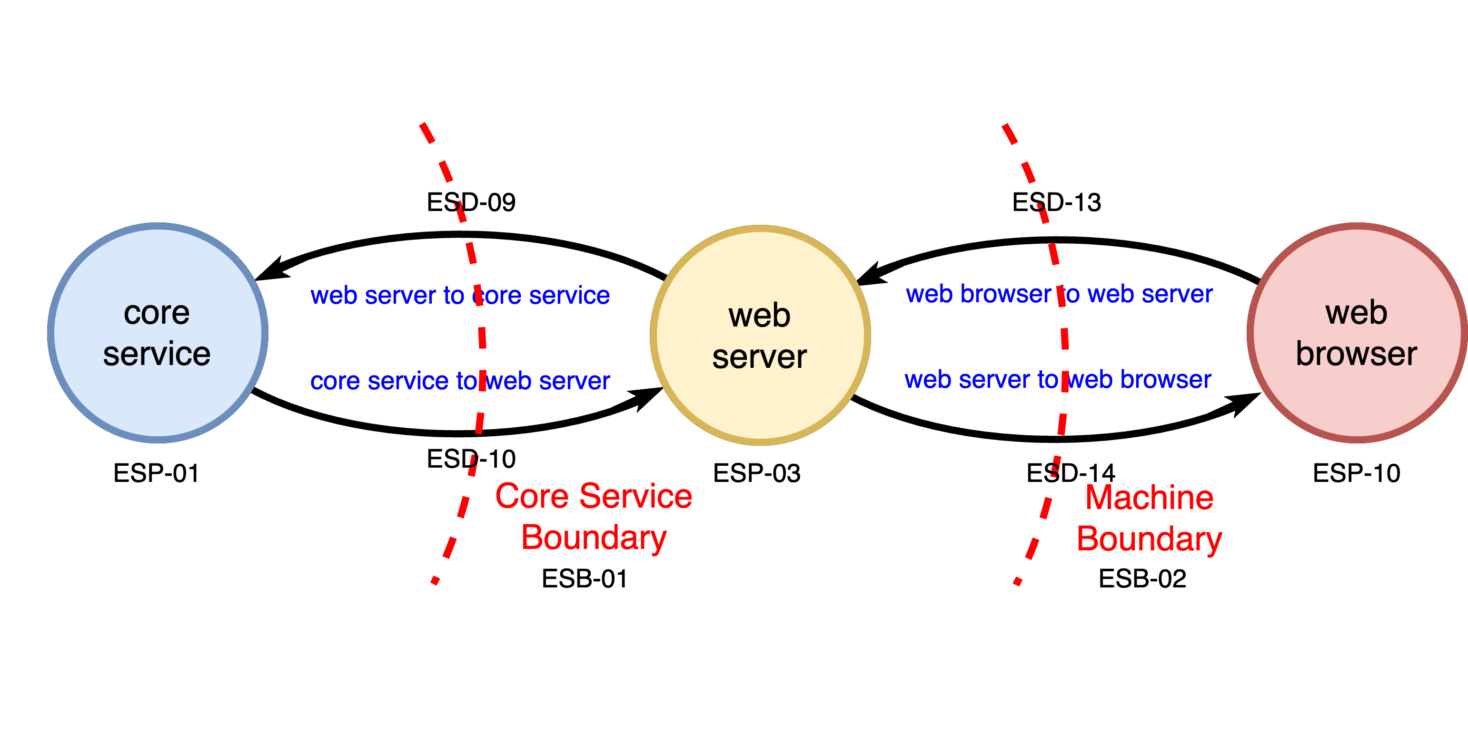
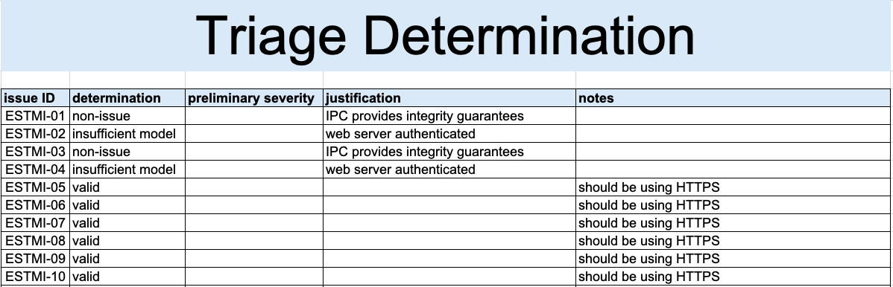
Triage Information
Notes:
Script:
Our threat modeling activity pointed to
[pause]
a subsection of the threat model’s DFD.
This yielded a set of
[pause]
identified issues.
These issues were then
[pause]
triaged.
The triage reduced the issues to a set of
[pause]
six valid threat candidates.

Slide 16
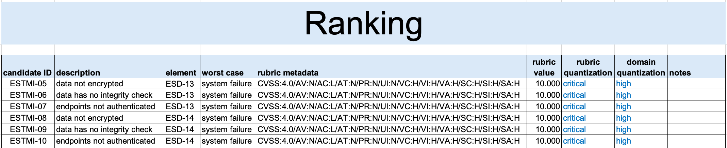
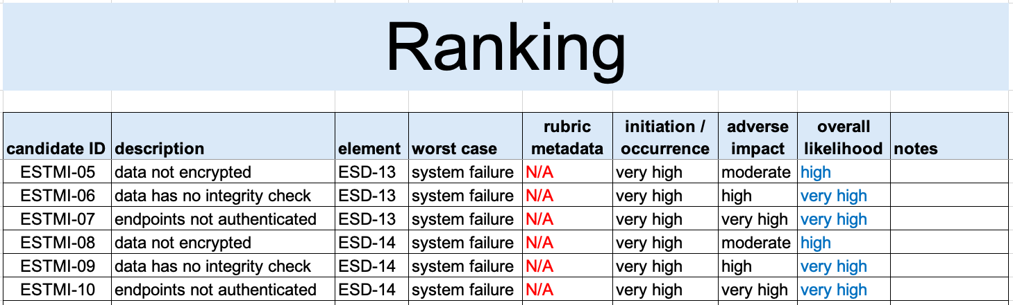
Ranking
CVSS
800-30
Notes:
Script:
Next, the six threat candidates were ranked, using both
[pause]
CVSS and
[pause]
NIST SP 800-30.
The outcome of this was that all of the issues needed to be addressed because in the case of CVSS, they were ranked as
[pause]
critical.
And in the case of SP 800-30, they were either
[pause]
high or very high.
Now let's look and see how we're going to address the risking or determination of impact for these six threat candidates.

Slide 17
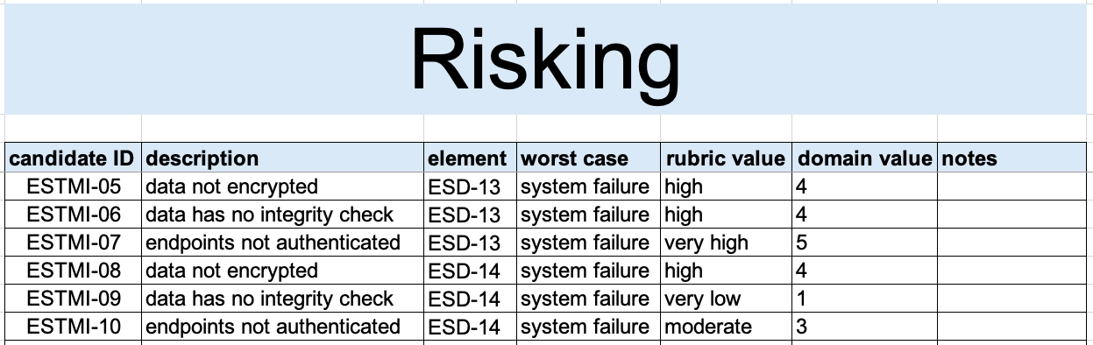
Risking
Notes:
Script:
Here's how we handle the risking.
We start by
[pause]
populating the information that the risk SME needs to have in order to make any determination.
That includes:
• the candidate ID
• its description
• the element in question
and
• the worst case scenario
all of which comes from the ranking activity.
The reason that we can use this limited subset of information is that every method that we use to record our activities provides references to its predecessor and the materials needed to construct the argument that we’re heading toward.
The risk SME is able then to just focus on their domain and what the threat candidate’s impact is.
That's going to be entered here as
[pause]
the rubric value.
When there is a specific domain that the overall system is in, whether that be medical, automotive, aerospace, or ICS, then
[pause]
a domain mapping can be provided which associates that rubric value to the domain’s required value.
Finally, we have
[pause]
notes.
It's assumed that the risk SME will consult with the appropriate individuals should clarification be necessary.
But fundamentally, this should be a very straightforward activity.

Slide 18
Recap
Notes:
Script:
That covers the threat prioritization process’ threat candidate risking activity.
Let's look at a summary.

Slide 19
Summary
Select an impact rubric
Set up the impact labels
Determine the impact value
Generate the human-readable report
Notes:
Script:
When conducting the threat candidate risking activity, first
[pause]
select an impact rubric.
This is probably going to be determined by the risk domain being applied.
[pause]
Next, set up the impact labels.
If you're using the provided templates, this ensures consistency and aids automation.
[pause]
Third, determine the impact value for each of the threat candidates.
[pause]
Finally, generate a human readable report.
We didn't go into detail here about that report because that's covered in the AVCDL Ranked / Risked Threat Report secondary document.

Slide 20
Example Materials
<AVCDL>/source/reference_documents/working_material/example system/
Notes:
Script:
The materials used to cover this example are in the location shown here.
It's important to note that this includes all the materials needed to replicate the activity as presented.

Slide 21
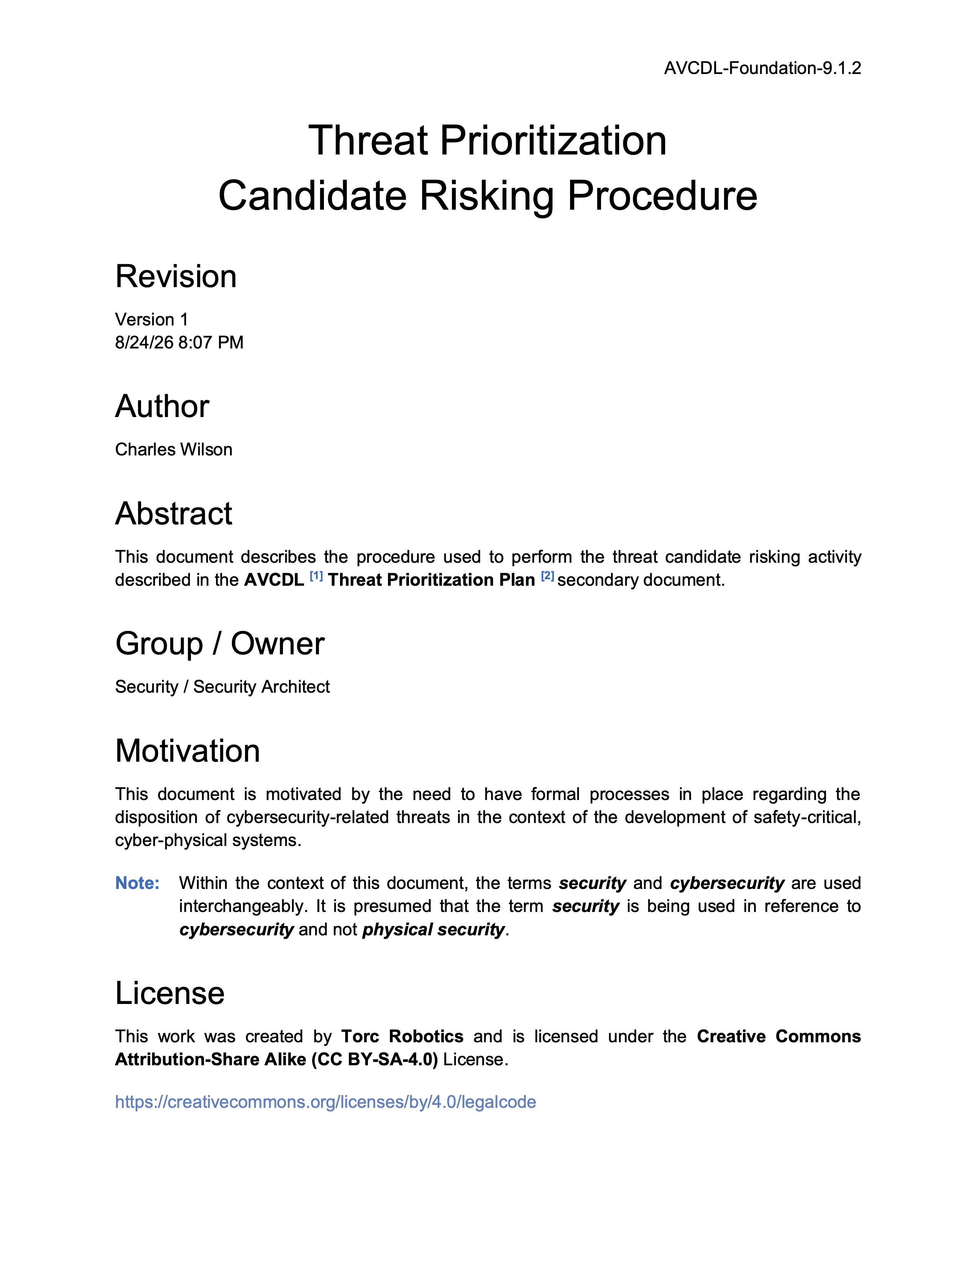
Further Reading
Notes:
Script:
For additional information and to get a more in-depth set of references, the Threat Prioritization – Candidate Risking Procedure tertiary document is available in the AVCDL GitHub repository.

Slide 22
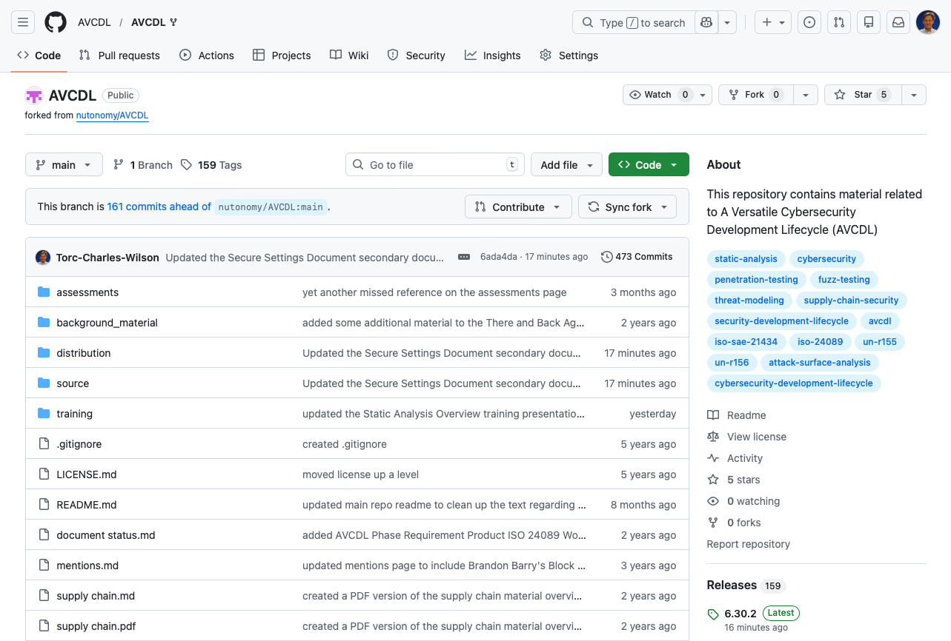
AVCDL on GitHub
https://github.com/AVCDL/AVCDL
Notes:
Script:
All AVCDL materials, both in source and distribution forms, are available on our GitHub site, as shown here.
Because of the size of the repository, it's recommended that you either clone the repository or download a ZIP archive of it, if you're not familiar with using git.
Instructions for downloading a ZIP archive are linked to on the repository’s front page.

Slide 23
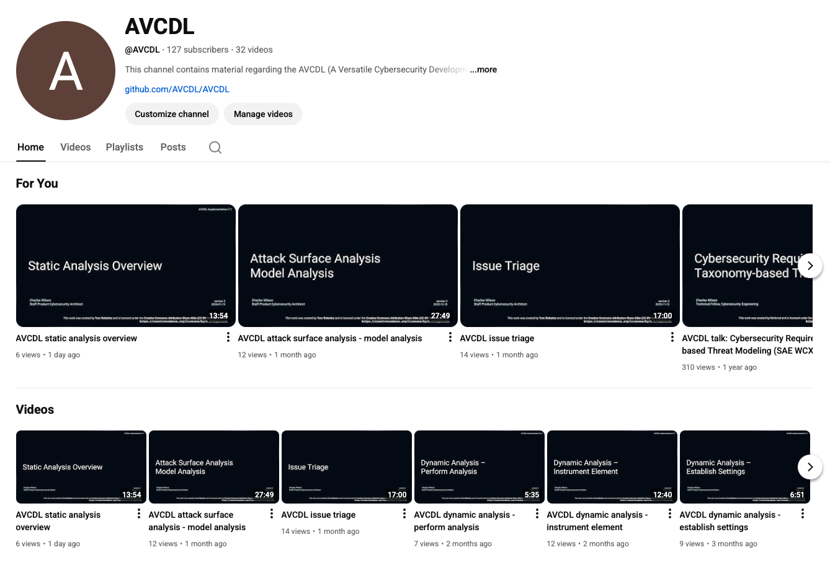
AVCDL on YouTube
https://youtube.com/@AVCDL
Notes:
Script:
Videos covering various aspects of the AVCDL are available on our YouTube channel, as shown here.
It's important to note that all AVCDL materials with the exception of the introductory blog posts are intended for product cybersecurity engineering practitioners.

Slide 24
Next Steps
Notes:
Script:
With this training complete, if you’ve completed the other trainings covering the Threat Prioritization process activities, you can proceed to
Attack surface analysis
Threat modeling
Penetration testing
and
Vulnerability identification
Additionally, if you’ve completed Secure Coding and it’s prerequisites, you can proceed to
Static analysis
Dynamic analysis
Fuzz testing
and
Secure code review

Slide 25
References (1 of 2)
AVCDL (AVCDL primary document)
Threat Prioritization Plan (AVCDL secondary document)
Threat Prioritization – Candidate Risking Procedure (AVCDL tertiary document)
AVCDL threat candidate risking template (AVCDL template)
Ranked / Risked Threat Report (AVCDL secondary document)
ISO/SAE 21434:2021 Road vehicles – Cybersecurity engineering https://www.iso.org/standard/70918.html
ISO 26262-3:2018 Road vehicles – Functional safety – Part 3: Concept phase
https://www.iso.org/standard/68385.html
ISO 14971:2019 Medical devices – Application of risk management to medical devices
https://www.iso.org/standard/72704.html
NIST SP 800-30 r1 - Guide for Conducting Risk Assessments
https://nvlpubs.nist.gov/nistpubs/Legacy/SP/nistspecialpublication800-30r1.pdf
Notes:
Script:
Here are references to the source material used in the creation of this presentation.
They'll also be included in the video description.
Additionally, this presentation’s source material will be provided on the AVCDL GitHub repository.

Slide 26
References (2 of 2)
NIST FIPS 199 Standards for Security Categorization of Federal Information and Information Systems
https://nvlpubs.nist.gov/nistpubs/FIPS/NIST.FIPS.199.pdf
Notes:
Script:
Here are references to the source material used in the creation of this presentation.
They'll also be included in the video description.
Additionally, this presentation’s source material will be provided on the AVCDL GitHub repository.

